Slide 1
Mitosis Event Detection and Quantification
Student: Gerda Bortsova
Supervisors: Dr. Lichao Wang, Dr. Carsten Marr

Slide 2
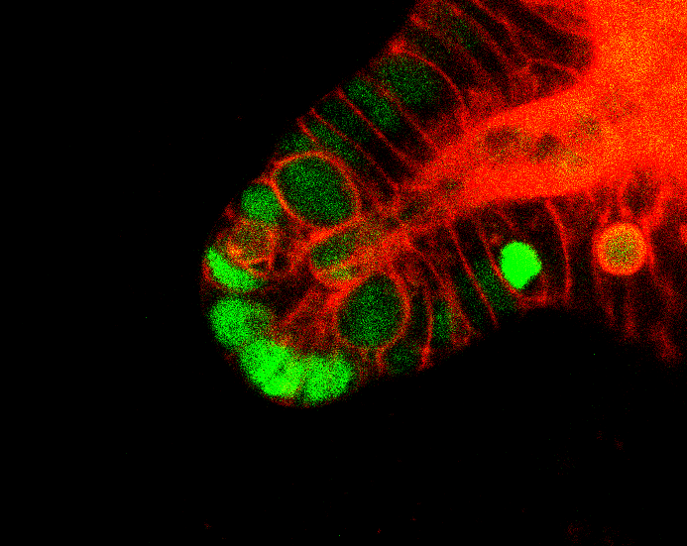
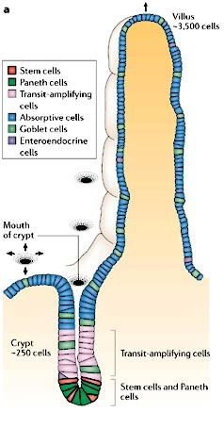
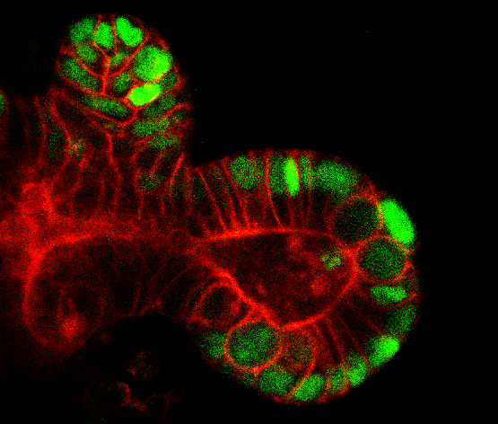
Introducing the problem I
The data: 4D (3D + time) images of intestinal crypt
Crypt is an invagination into mucosa of intestine
The bottom of the crypt is place where stem cells are actively proliferating to facilitate renewal of intestinal epithelium
Patterns of cell division may be linked to diabetes
The distribution of epithelial cell types in the mammalian small intestine. [link]
The data: central slices.

Slide 3
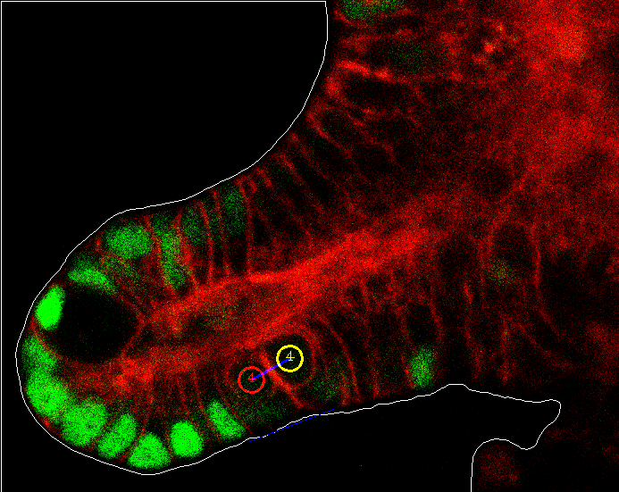
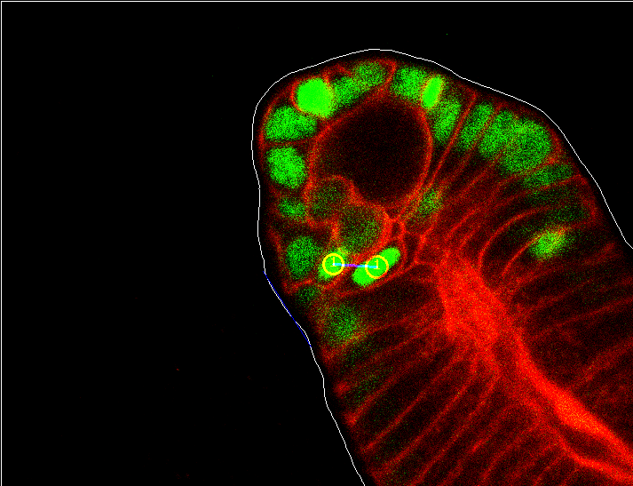
Introducing the problem II
More concretely, my task is to aid biologists to measure a statistics of angle between cells arisen from division and the crypt surface. (If they are more perpendicular to the surface or more parallel.)

Slide 4
Introducing the problem II
This includes:
Automatic extraction of crypt surface
Developing a method to measure angle between the surface and daughter cells
Detection of mitosis events

Slide 5
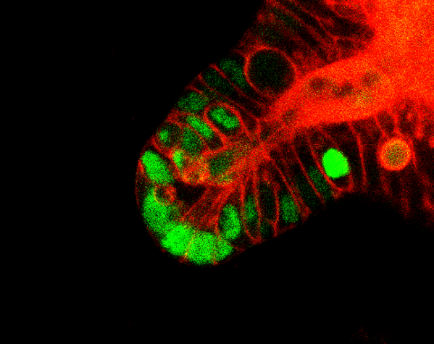
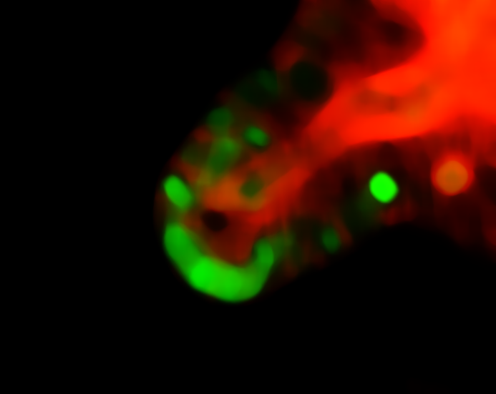
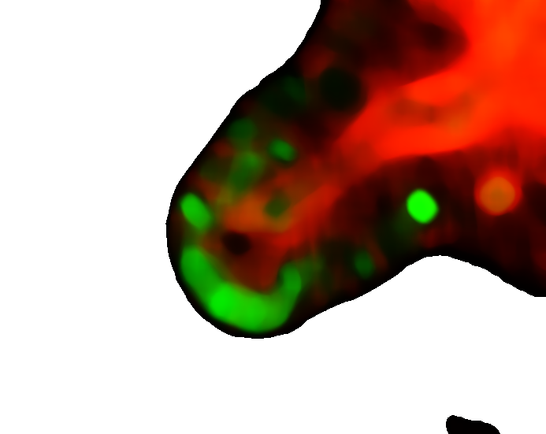

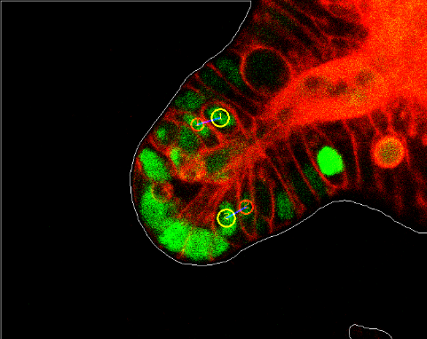
Extraction of crypt surface
Application of Statistical Shape Models (SSM) was considered.
However, the problem appeared to be easily solved by simple Flood Fill algorithm and subsequent extraction of the outmost contour by an algorithm to determine topological structure of a binary image resulting from Flood Fill.

Slide 6
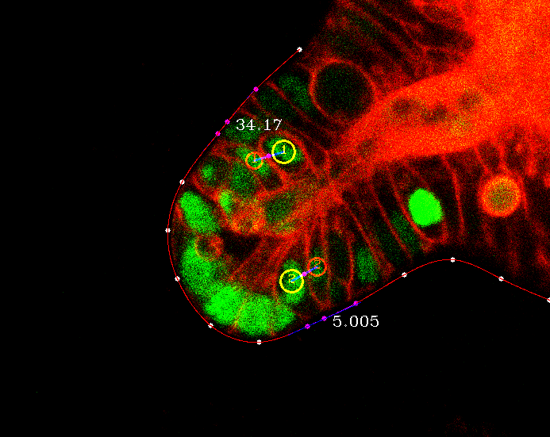
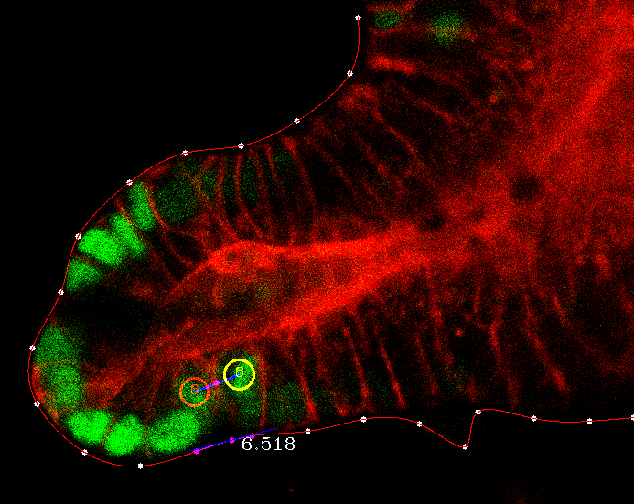
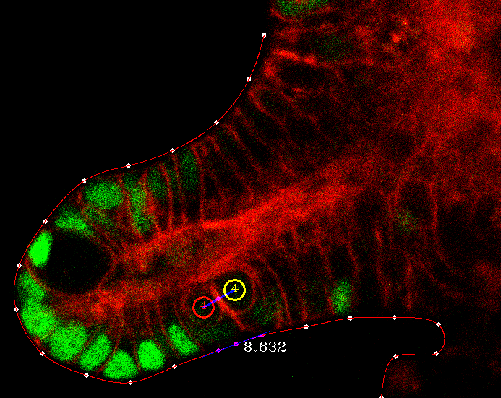

The method for measuring angle
Sample points of equal distance from the crypt
Interpolate using cubic spline
Calculate an angle between:
a line connecting daughter cells and
tangent line at the point of the crypt closest to a central point of a line segment connecting the daughters

Slide 7
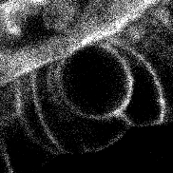
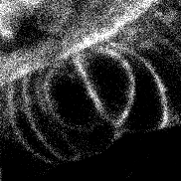
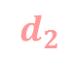
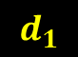

What is mitosis event?
Technically, a mitosis event is a set of three points:
A center of mother cell
Centers of daughter cells arisen from the division of mother
$$m$$
$$d_{1}$$
$$d_{2}$$
Time Frame #97
Time Frame #98

Slide 8
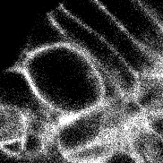
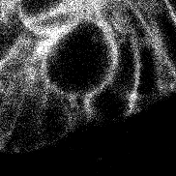
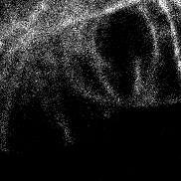
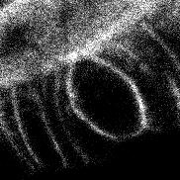
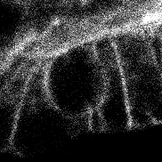
Detection of mitosis events: workflow
The first step: build two classifiers for detection of mother and daughter.
To build classifier meaningful features are needed.
Mother cell has particular (near-round) shape
Features describing shape could be especially helpful
Notes:
Draw flowchart

Slide 9
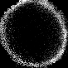
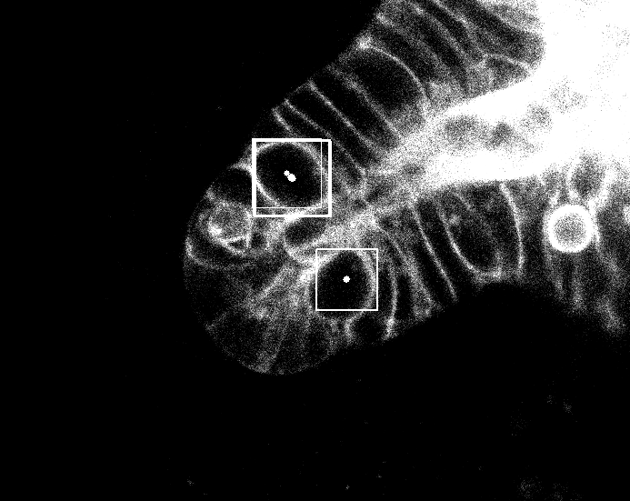
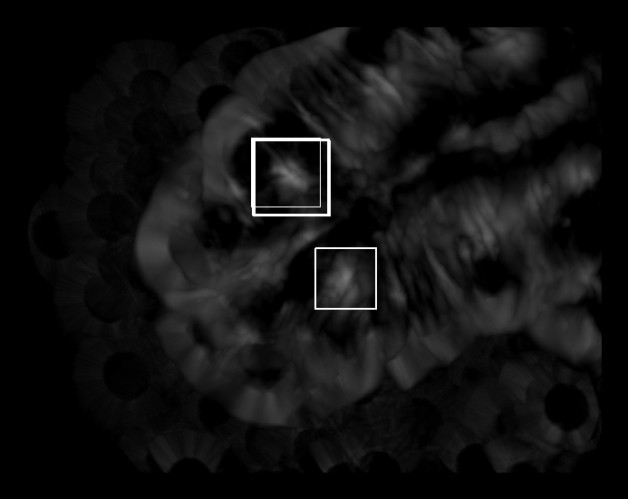
Features: template matching I
Choosing so-called template: image containing only the object
At each point of target image calculate a similarity measure (I took cross-correlation) of a local patch and the template

Slide 10
Features: template matching II
Problem: cells may have different sizes and not exactly circular shape
Solution: search only for a single template, but for it’s linear transformations

Slide 11
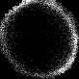

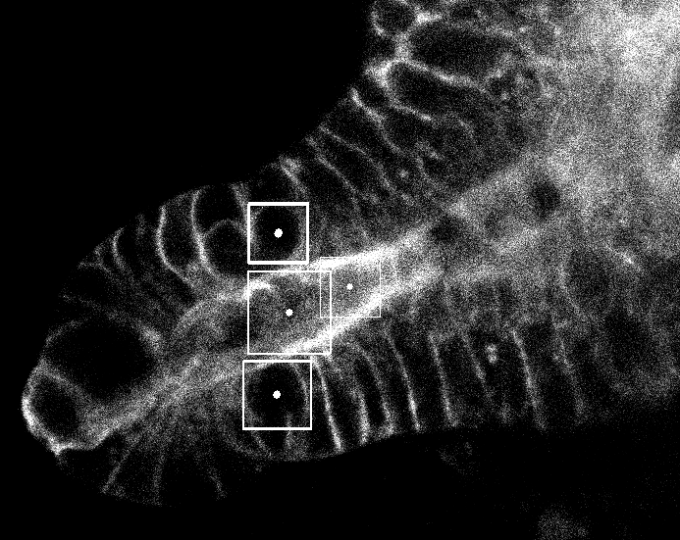
Features: template matching III
Other drawbacks:
Depends on choice of the template -> time-consuming to choose a good set of templates
Gives false positives (and negatives) -> use in combination with other features

Slide 12
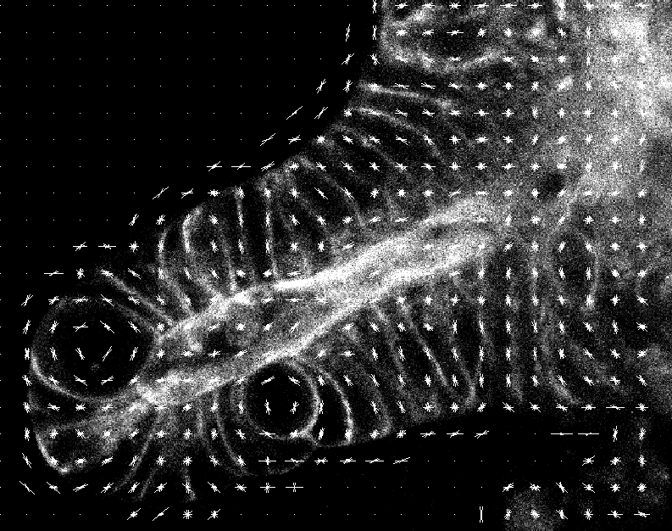
Features: histogram of gradients (HoG) I
Good representation of shape of the object

Slide 13
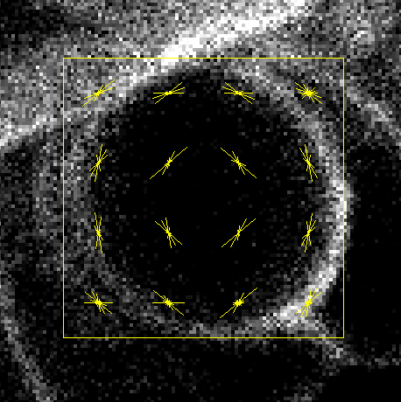
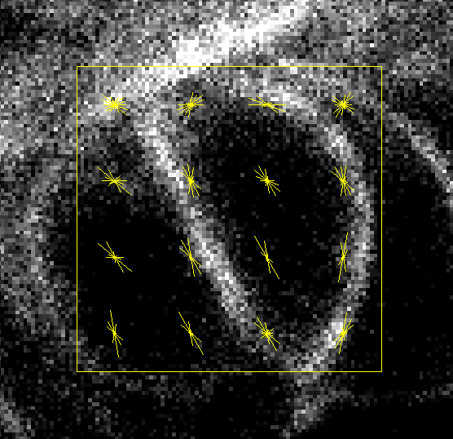
Features: histogram of gradients (HoG) II
Extract HoG not only at cell’s time frame, but from next frame for mother and previous for daughter:
+

Slide 14
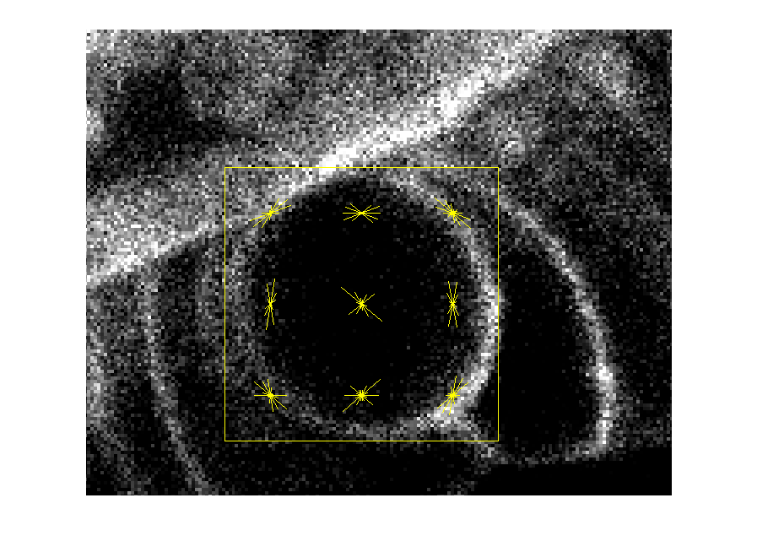
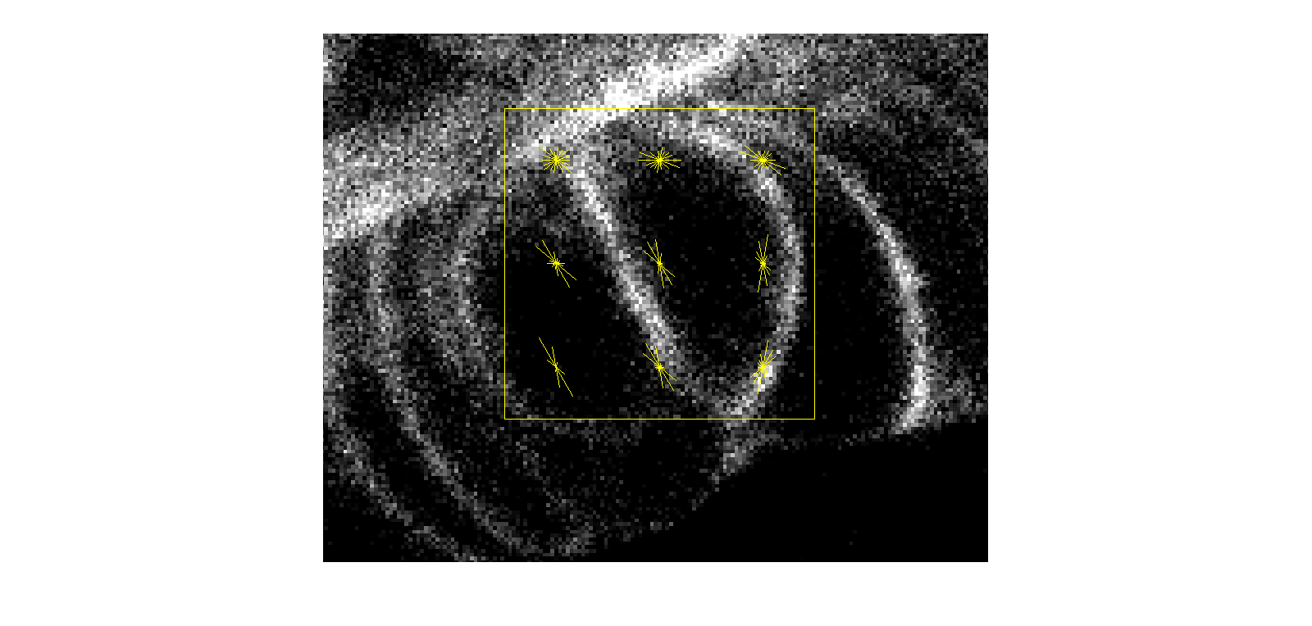
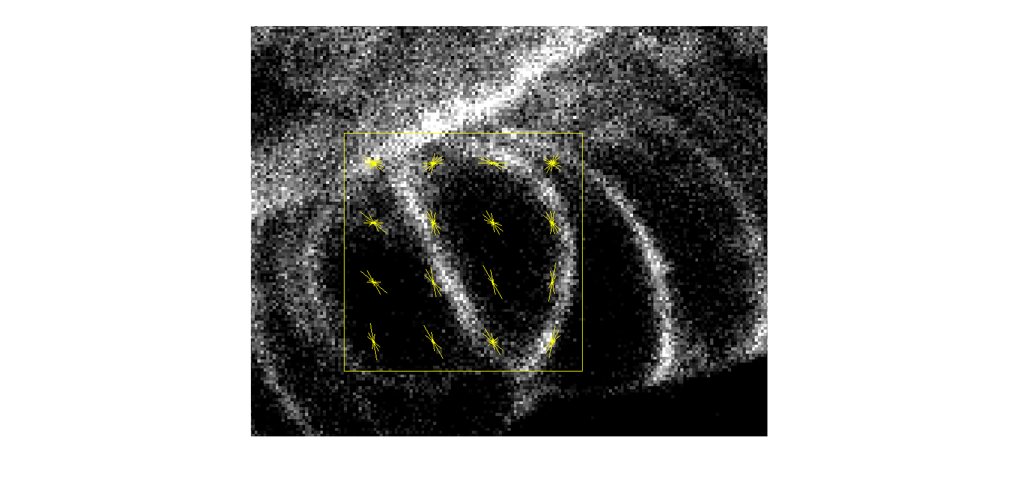
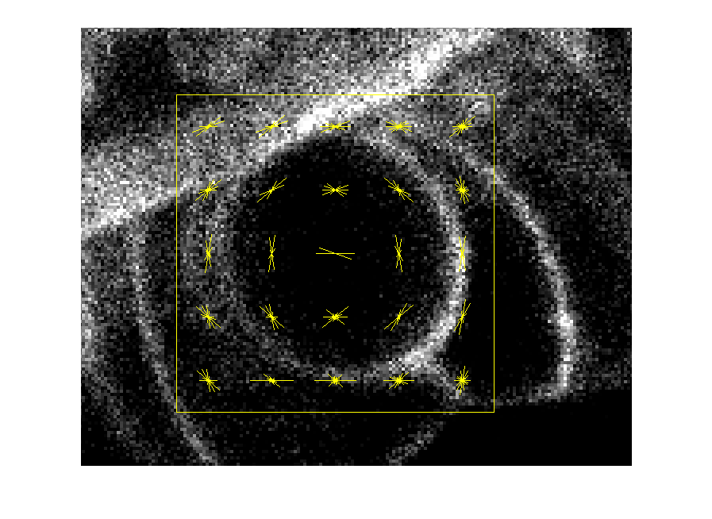
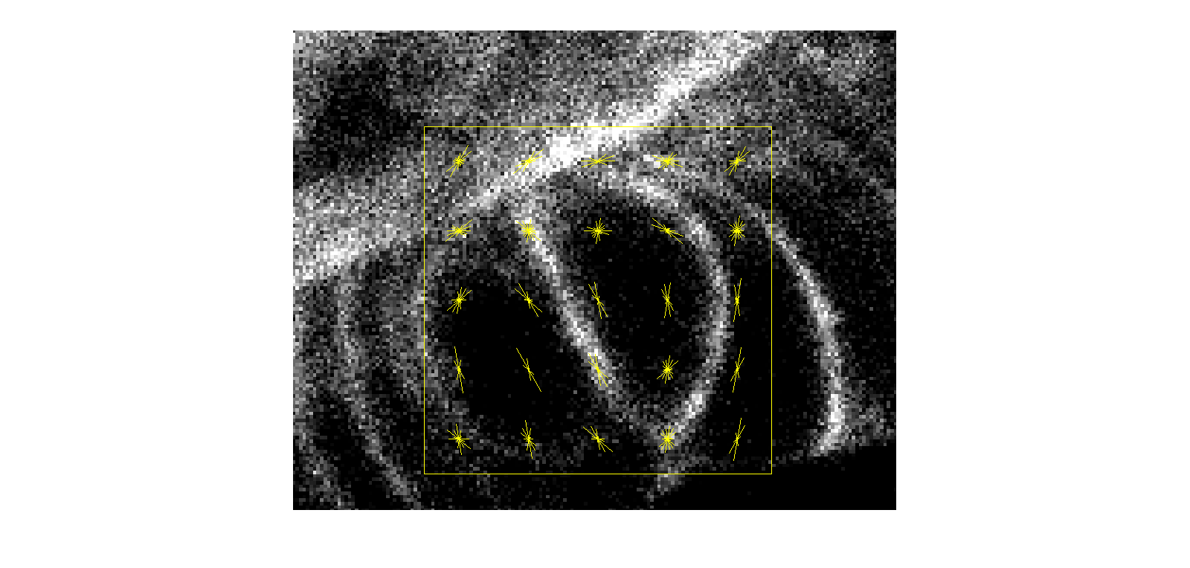
Features: histogram of gradients (HoG) II
Problem: choose number of cells
3X3
4X4
5X5
Parameters:
81
144
255
Parameters
Descriptiveness
Notes:
NOT ROTATION INVARIANT

Slide 15
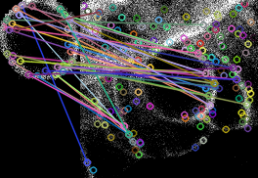
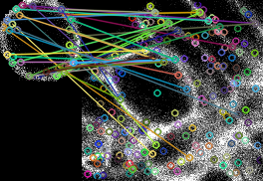
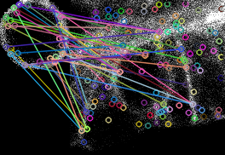
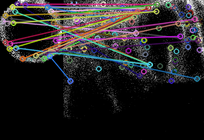
Features: SIFT (Scale-Invariant Feature Transform)
Finds interesting points (keypoints) in both source and target images
Finds closest points on the target image to points on the source by comparing their HoGs
Fails:
(Trying to find template on the image it was taken from.)

Slide 16
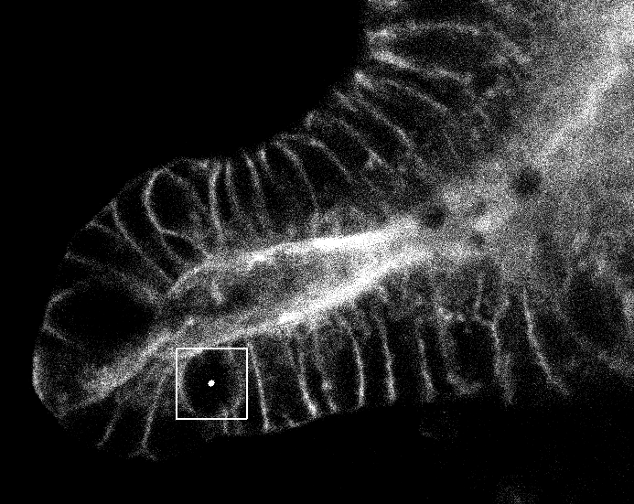
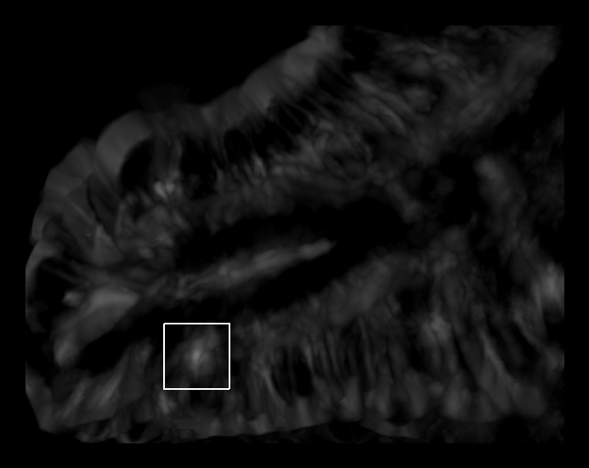
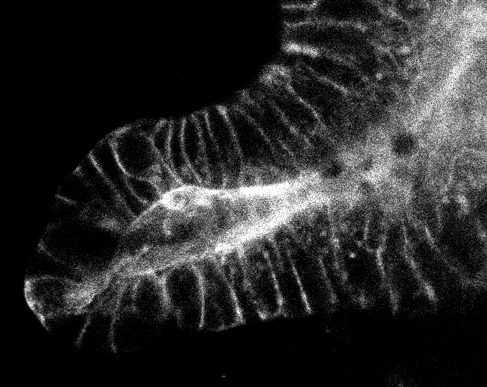
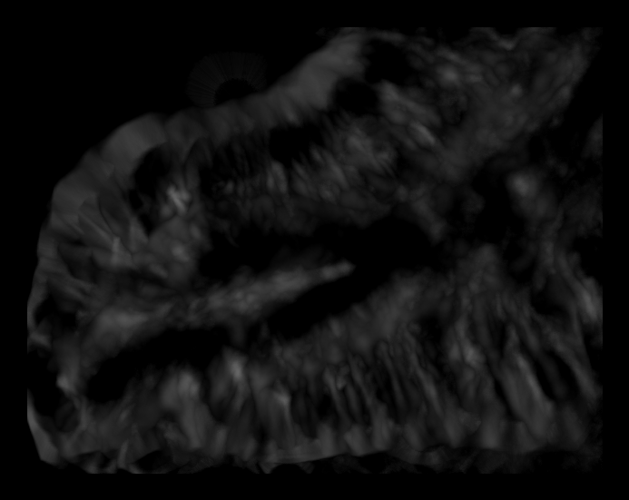
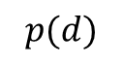

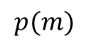
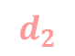



The Plan
Extract features for both type of cells
Train two classifiers
Try every possible location m of mother cell, d1 and d2 of daughter cells and choose one with highest joint likelihood
Ambiguity
$$p(m)$$
$$p(d)$$
$$d_{2}$$
?
$$d_{1}$$
$$d_{2}$$
$$m$$
$$d_{1}$$
Notes:
Second block

Slide 17
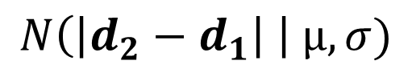
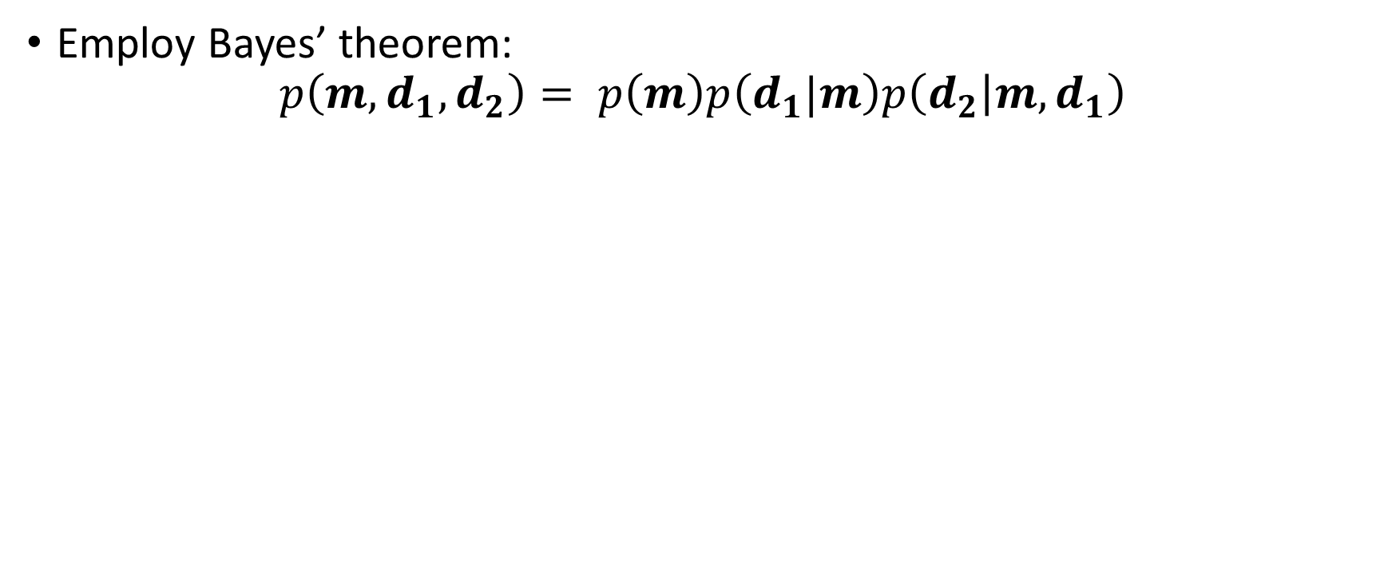
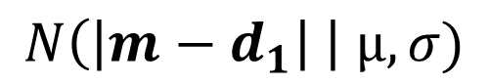
Estimating joint likelihood: Bayes I
Employ Bayes’ theorem:
$$p\left(m, d_{1}, d_{2}\right)= p\left(m\right)p\left(d_{1}|m\right)p\left(d_{2} | {m, d}_{1}\right)$$
$$N\left(\left|m−d_{1}\right| \right| µ, σ)$$
$$N\left(\left|d_{2}−d_{1}\right| \right| µ, σ)$$
output of mother classifier

Slide 18
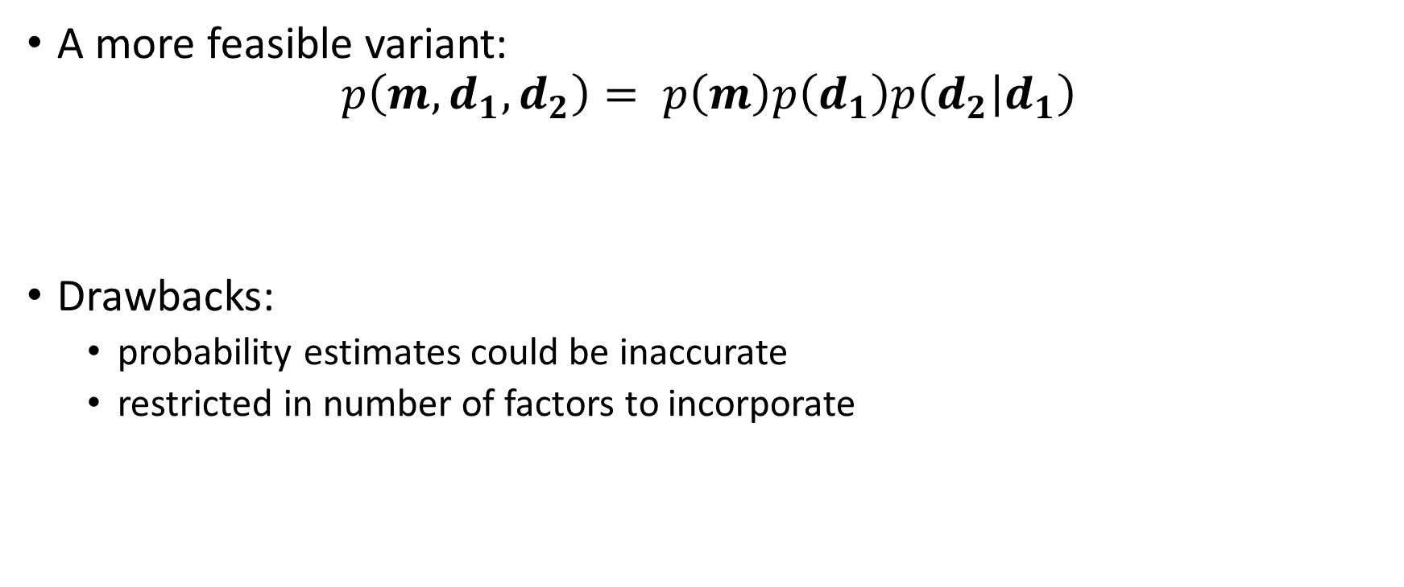
Estimating joint likelihood: Bayes II
A more feasible variant:
$$p\left(m, d_{1}, d_{2}\right)= p\left(m\right)p\left(d_{1}\right)p\left(d_{2} | d_{1}\right)$$
Drawbacks:
probability estimates could be inaccurate
restricted in number of factors to incorporate
$$N\left(\left|d_{2}−d_{1}\right| \right| µ, σ)$$
output of mother classifier
output of daughter classifier

Slide 19
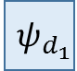











Conditional Random Field (CRF) formulation
$$x$$
$U = \left\{m, d_{1}, d_{2}\right\}$
$B=\left\{\left(m,d_{1}\right),\left(m,d_{2}\right), \left(d_{1},d_{2}\right)\right\}$
$T = \{(m, d_{1},d_{2})\}$
$$p\left(m, d_{1},d_{2} | x\right)=\frac{1}{Z(x)}\prod_{i∊U}{ψ_{i}\left(i, x\right)}\prod_{(i, j)∊B}{ψ_{ij}(i, j)}\prod_{(i, j, k)∊T}{ψ_{ijk}(i, j, k)}$$
$${ ψ}_{d_{1}}$$
$${ ψ}_{m}$$
$${ ψ}_{d_{2}}$$
$${ d}_{1}$$
$${ ψ}_{md_{1}}$$
$${ ψ}_{md_{2}}$$
$$m$$
$${ ψ}_{md_{1}d_{2}}$$
$${ d}_{2}$$
$${ ψ}_{d_{1}d_{2}}$$
Notes:
ESTIMATES conditional prob

Slide 20

CRF formulation: potentials
Unary potentials:
$$ψ_{m}\left(m,x\right)=\exp{\{w_{m}p\left(m\right)\}}$$
Binary potentials:
$$ψ_{d_{1}d_{2}}\left(d_{1},d_{2},x\right)=exp⁡\{w_{d_{1}d_{2}}N\left(\left|d_{2}−d_{1}\right| \right| µ, σ)\}$$
$$ψ_{{md}_{1}}\left(m,d_{1},x\right)=exp⁡\{w_{{md}_{1}}N\left(\left|m−d_{1}\right| \right| µ, σ)\}$$
Ternary potential:
$$ψ_{{md}_{1}d_{2}}\left(m,d_{1},d_{2},x\right)=exp⁡\{w_{{md}_{1}d_{2}}N\left(\left|m−d_{1}\right|−\left|m−d_{2}\right|\right| µ, σ)\}$$

Slide 21

CRF formulation: weights
In some works weights are chosen empirically. [link]
Disadvantages:
Requires time to tune
May be inaccurate
Better option: learn weights by maximizing likelihood:
$$\hat{w}={\arg{max}}_{w}\prod_{\left\{n=1\right\}}^{N}{p(m^{n},d_{1}^{n}, d_{1}^{n}|x^{n})}$$
$m^{n},d_{1}^{n}, d_{1}^{n}$ - labels of $n$th sample $x^{n}$

Slide 22
The schedule
The task | Time
Feature extraction: | 3 weeks
Implement template matching with scale, rotation, reflection | 1 week
Test template matching with different templates, choose a good subset | 1 week
Implement HoG, color-based features and test | 1 week
Prepare data for mothers and daughters individual detection: | 1 week
Separate data into testing and training set (70-30) and extract features from positive samples and a set of random points | 1 week
Train classifiers for detection of mothers and daughters: | 1 week
Train random forest on the prepared data; tune the parameters with cross-validation. | 1 week
Mitosis event detection with Bayes: | 2 weeks
Implement mitosis detection with Bayes’ method. | 1 week
Assess the performance. | 1 week

Slide 23

The schedule
The task | Time
Prepare training data for mitosis event (joint) detection: | 1 week
Sample random triples (m, d1, d2); sample random triples using distributions $p\left(d_{1}|m\right)$ and $p\left(d_{2} | {m, d}_{1}\right)$; extract features of sampled negatives and positives. | 1 week
Mitosis event detection with CRF: | 2 weeks
Implement CRF and learn weights. | 1 week
Assess the performance and compare with Bayes’. | 1 week
Total: | 10 weeks

